Slide 1
Secure Data hiding in images using Steganography
PROJECT
Presented By
Bedanga Das
Guru Nanak Institute of Technology (MCA)

Slide 2
OUTLINE
Problem Statement
Technology used
Wow factor
End users
Result
Conclusion
Git-hub Link
Future scope

Slide 3
Problem Statement
In today's digital world, secure communication is a major concern, as sensitive data can be intercepted during transmission .This project implements
image steganography to hide encrypted messages inside images . The system ensures data confidentiality by making hidden messages undetectable
to the human eye. It is developed to allow users to encode and decode messages
easily, enhancing privacy and security.

Slide 4
Technology used
The project leverages multiple technologies for image processing, encryption and decryption
Google Colab – To develop and run the project in a cloud environment.
Encryption & Decryption Algorithm - Basic substitution encoding using pixel values to hide the message, hidden message is extracted from the image by decoding the pixel values.
Python 3 – The core language used for implementation.
Libraries & Frameworks Used
Library | Purpose
NumPy (numpy) | For handling image pixel data in arrays.
OpenCV (cv2) | For reading, processing, and saving images.
OS (os) | Used to interact with the system (eg. Opening files)
String | For character encoding and manipulation.

Slide 5
Wow factors
Unlike traditional steganography projects, this implementation includes multiple security enhancements and user-friendly features, making it more secure, accessible, and practical , This project stands out by implementing image-based steganography, where secret messages are hidden in image pixels using RGB values. It incorporates password protection, allowing only authorized users to decrypt the message. Unlike standard encryption, the hidden message is embedded directly within the image, making it invisible to the naked eye. The project uses OpenCV for image manipulation, offering a simple but effective approach. With customizable passcodes for each encryption, it ensures flexible access control. The addition of file handling for password storage increases practicality. These features combine to create a unique, secure, and easy-to-understand system for hidden communication.
Fully Cloud-Deployable (Runs in Google Colab) No setup needed
Can be executed directly in Google Colab. Cross-Platform Compatibility Works on Windows, Mac, and Linux.
Supports PNG, JPG, and JPEG images.

Slide 6
End users
The end user of this project can be anyone who needs to securely hide and share sensitive information.
It is ideal for cybersecurity professionals, journalists, government officials, and individuals concerned
about privacy . With its easy-to-use web interface, even non-technical users can encrypt and embed
messages into images effortlessly. The project ensures that only authorized recipients can Extract and
Decrypt the hidden information . Whether for personal privacy or secure corporate communication,
this tool offers a simple yet powerful solution.

Slide 7
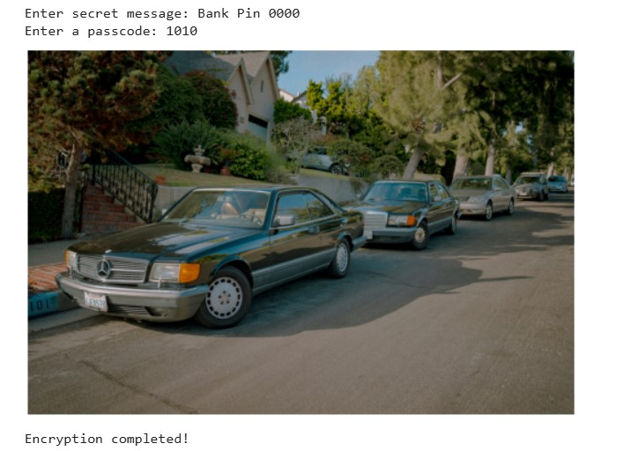

Results

Slide 8
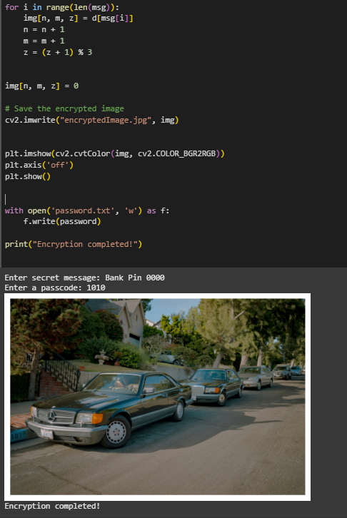
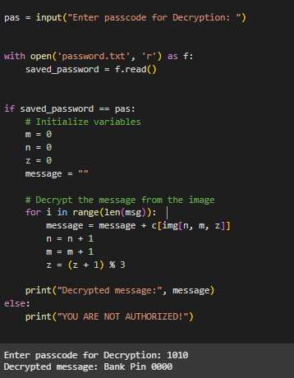

Slide 9
Conclusion
This project successfully integrates encryption and steganography to provide a secure and undetectable method
For hiding messages in images. With a user-friendly interface in goolge colab, it ensures accessibility
for both technical and non-technical users. By embedding secret messages within image pixels, it provides an
added layer of security while ensuring ease of use with OpenCV.
Overall, it offers a practical solution for secure communication, blending cryptography and image manipulation in
an intuitive and accessible way . Its cross-platform compatibility and cloud deployment make it a practical
real-world solution. Overall, this project offers an efficient, secure, and easy-to-use tool for confidential data
transmission.

Slide 10
GitHub Link
https://github.com/Bedanga864/Steganography.git

Slide 11
The future scope of this project includes enhancing security by integrating stronger encryption algorithms like
AES-256 or RSA. AI-based steganalysis resistance can be implemented to make detection even harder. Support
for video and audio steganography can expand its use beyond images. A mobile application can be developed
for secure message hiding on smartphones. Cloud-based storage and retrieval can enable users to save and
access stego images remotely. Finally, multi-user authentication can be added to restrict access and improve
further security to the overall Application.
Future scope(optional)

Slide 12
THANK YOU

